Slide 1



SOFTWARE ENGINEERING with
203105303
Prof. Jignasha Parmar, Assistant Professor
Information and Technology

Slide 2


UNIT-2
Software Project Management
Planning a Software Project

Slide 3
Software Project Management
Management Spectrum, People – Product – Process- Project, W5HH Principle, Importance of Team Management
Planning a Software Project
Scope and Feasibility, Effort Estimation, Schedule and staffing, Quality Planning, Risk management- identification, assessment, control, project monitoring plan, Detailed Scheduling

Slide 4
W⁵HH of Project Management
Boehm suggests an approach (W5HH) that addresses project objectives, milestones and schedules, responsibilities, management and technical approaches and required resources
Why is the system being developed?
Enables all parties to assess the validity of business reasons for the software work. In another words - does the business purpose justify the expenditure of people, time, and money?
What will be done?
The answers to these questions help the team to establish a project schedule by identifying key project tasks and the milestones that are required by the customer
When will it be accomplished?
Project schedule to achieve milestone
Image source : Google

Slide 5
W⁵HH of Project Management Cont.
Who is responsible?
Role and responsibility of each member
Where are they organizationally located?
Customer, end user and other stakeholders also have responsibility
How will the job be done technically and managerially?
Management and technical strategy must be defined
How much of each resource is needed?
Develop estimation
W⁵HH
It is applicable regardless of size or complexity of software project

Slide 6
Terminologies
Measure
  It provides a quantitative indication of the extent (range), amount, dimension, capacity or size of some attributes of a product or process
  Ex., the number of uncovered errors
Metrics
  It is a quantitative measure of the degree (limit) to which a system, component or process possesses (obtain) a given attribute
  It relates individual measures in some way
  Ex., number of errors found per review
Direct Metrics
  Immediately measurable attributes
  Ex., Line of Code (LOC), Execution Speed, Defects Reported

Slide 7
Terminologies
Indirect Metrics
  Aspects that are not immediately quantifiable
  Ex., Functionality, Quantity, Reliability
Indicators
  It is a metric or combination of metrics that provides insight into the software process, project or the product itself
  It enables the project manager or software engineers to adjust the process, the project or the product to make things better
  Ex., Product Size (analysis and specification metrics) is an indicator of increased coding, integration and testing effort
Faults
  Errors - Faults found by the practitioners during software development
  Defects - Faults found by the customers after release

Slide 8
Why Measure Software?
To determine (to define) quality of a product or process.
To predict qualities of a product or process.
To improve quality of a product or process.

Slide 9
Metric Classification Base
Process
  Specifies activities related to production of software.
  Specifies the abstract set of activities that should be performed to go from user needs to final product.
Project
  Software development work in which a software process is used
  The actual act of executing the activities for some specific user needs
Product
  The outcomes of a software project
  All the outputs that are produced while the activities are being executed

Slide 10
Process Metrics
Process Metrics are an invaluable tool for companies to monitor, evaluate and improve their operational performance across the enterprise
They are used for making strategic decisions
Process Metrics are collected across all projects and over long periods of time
Their intent is to provide a set of process indicators that lead to long-term software process improvement
Ex., Defect Removal Efficiency (DRE) metric
Relationship between errors (E) and defects (D)
The ideal is a DRE of 1
DRE = E / ( E + D )

Slide 11
Process Metrics Cont.
We measure the effectiveness of a process by deriving a set of metrics based on outcomes of the process such as,
1. Errors uncovered before release of the software
2. Defects delivered to and reported by the end users
3. Work products delivered
4. Human effort expended
5. Calendar time expended
6. Conformance to the schedule
7. Time and effort to complete each generic activity

Slide 12
Project Metrics
Project metrics enable a software project manager to,
  Assess the status of an ongoing project
  Track potential risks
  Uncover problem areas before their status becomes critical
  Adjust work flow or tasks
  Evaluate the project team’s ability to control quality of software work products
Many of the same metrics are used in both the process and project domain
Project metrics are used for making tactical (smart) decisions
They are used to adapt project workflow and technical activities

Slide 13
Project Metrics Cont.
Project metrics are used to
Minimize the development schedule by making the adjustments necessary to avoid delays and mitigate (to reduce) potential (probable) problems and risks.
Assess (evaluates) product quality on an ongoing basis and guides to modify the technical approach to improve quality.

Slide 14
Product Metrics
Product metrics help software engineers to gain insight into the design and construction of the software they build
  By focusing on specific, measurable attributes of software engineering work products
Product metrics provide a basis from which analysis, design, coding and testing can be conducted more objectively and assessed more quantitatively
  Ex., Code Complexity Metric

Slide 15
Types of Measures
Categories of
Software Measurement
Software
Measurement
Direct measures of the
Metrics for Software Cost and Effort estimations
Software process
Ex., cost, effort, etc.
Size Oriented Metrics
Software product
Ex., lines of code produced,
execution speed,
defects reported, etc.
Function Oriented Metrics
Object Oriented Metrics
Use Case Oriented Metrics
Indirect measures of the
Software product
Ex. functionality, quality, complexity, efficiency, reliability, etc.

Slide 16
Size-Oriented Metrics
Derived by normalizing (standardizing) quality and/or productivity measures by considering the size of the software produced
Thousand lines of code (KLOC) are often chosen as the normalization value
A set of simple size-oriented metrics can be developed for each project
  Errors per KLOC (thousand lines of code)
  Defects per KLOC
  $ per KLOC
  Pages of documentation per KLOC

Slide 17
Size-Oriented Metrics Cont.
Size-oriented metrics are not universally accepted as the best way to measure the software process
Opponents argue that KLOC measurements
  Are dependent on the programming language
  Penalize well-designed but short programs
  Cannot easily accommodate nonprocedural languages
  Require a level of detail that may be difficult to achieve

Slide 18
Function Oriented Metrics
Function-oriented metrics use a measure of the functionality delivered by the application as a normalization value
Most widely used metric of this type is the Function Point
  FP = Count Total * [0.65 + 0.01 * Sum (Value Adjustment Factors)]
Function Point values on past projects can be used to compute,
  for example, the average number of lines of code per function point

Slide 19
Function Oriented Metrics Cont.
Metrics
Advantages
  FP is programming language independent
  FP is based on data that are more likely to be known in the early stages of a project, making it more attractive as an estimation approach
Disadvantages
  FP requires some “sleight of hand” because the computation is based on subjective data
  Counts of the information domain can be difficult to collect
  FP has no direct physical meaning, it’s just a number

Slide 20
Object-Oriented Metrics
Conventional software project metrics (LOC or FP) can be used to estimate object-oriented software projects
However, these metrics do not provide enough granularity (detailing) for the schedule and effort adjustments that are required as you iterate through an evolutionary or incremental process
Lorenz and Kidd suggest the following set of metrics for OO projects
  Number of scenario scripts
  Number of key classes (the highly independent components)
  Number of support classes

Slide 21
Function Point Metrics
The function point (FP) metric can be used effectively as a means for measuring the functionality delivered by a system
Using historical data, the FP metric can be used to
  Estimate the cost or effort required to design, code, and test the software
  Predict the number of errors that will be encountered during testing
  Forecast the number of components and/or the number of projected source lines in the implemented system

Slide 22
Function Point Components Cont..
Information domain values (components) are defined in the following manner
Number of external inputs (EIs)
  input data originates from a user or is transmitted from another application
Number of external outputs (EOs)
  external output is derived data within the application that provides information to the user output refers to reports, screens, error messages, etc.
Number of external inquiries (EQs)
  external inquiry is defined as an online input that results in the generation of some immediate software response in the form of an online output
Number of internal logical files (ILFs)
  internal logical file is a logical grouping of data that resides within the application’s boundary and is maintained via external inputs
Number of external interface files (EIFs)
  external interface file is a logical grouping of data that resides external to the application but provides information that may be of use to the another application

Slide 23
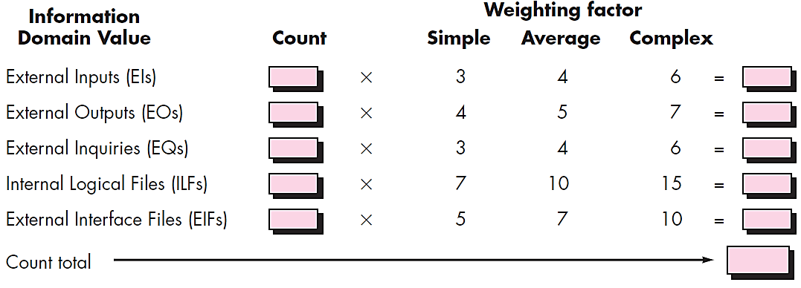
Compute Function Points
FP = Count Total * [ 0.65 + 0.01 * ∑(F_{i}) ]
Count Total is the sum of all FP entries
Fi (i=1 to 14) are complexity value adjustment factors (VAF).
Value adjustment factors are used to provide an indication of problem complexity

Slide 24
Compute Function Points Cont.
Value Adjustment Factors
F1. Data Communication
F2. Distributed Data Processing
F3. Performance
F4. Heavily Used Configuration
F5. Transaction Role
F6. Online Data Entry
F7. End-User Efficiency
F8. Online Update
F9. Complex Processing
F10. Reusability
F11. Installation Ease
F12. Operational Ease
F13. Multiple Sites
F14. Facilitate Change

Slide 25
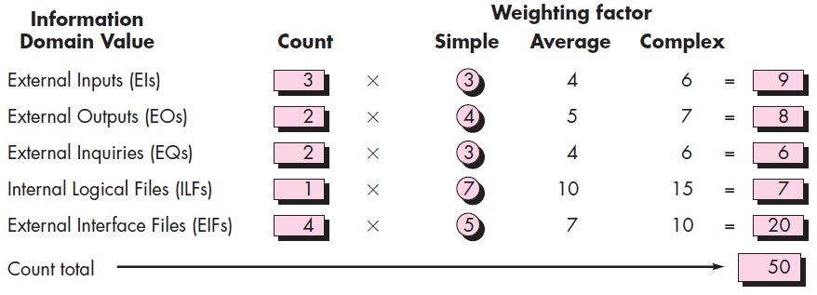
Compute Function Points Cont.
Function Point Calculation Example

Slide 26
Compute Function Points Cont.
Used Adjustment Factors and assumed values are,
F09. Complex internal processing = 3
F10. Code to be reusable = 2
F13. Multiple sites = 3
F03. High performance = 4
F02. Distributed processing = 5
Project Adjustment Factor (VAF) = 17
FP = Count Total * [ 0.65 + 0.01 * ∑(F_{i}) ]
FP = [50]* [0.65 + 0.01 * 17]
FP = [50]* [0.65 + 0.17]
FP = [50]* [0.82] = 41

Slide 27
Compute Function Points Cont.
Function Point Calculation Example 2
Study of requirement specification for a project has produced following results
Need for 7 inputs, 10 outputs, 6 inquiries, 17 files and 4 external interfaces
Input and external interface function point attributes are of average complexity and all other function points attributes are of low complexity
Determine adjusted function points assuming complexity adjustment value is 32.

Slide 28
Software Project Estimation
It can be transformed from a black art to a series of systematic steps that provide estimates with acceptable risk
To achieve reliable cost and effort estimates, a number of options arise:
  Delay estimation until late in the project (obviously, we can achieve 100 percent accurate estimates after the project is complete!)
  Base estimates on similar projects that have already been completed
  Use relatively simple decomposition techniques to generate project cost and effort estimates
  Use one or more empirical models for software cost and effort estimation.

Slide 29
Software Project Estimation
Software project estimation is a form of problem solving and in most cases, the problem to be solved is too complex to be considered in one piece
For this reason, decomposing the problem, re-characterizing it as a set of smaller problems is required
Before an estimate can be made, the project planner must understand the scope of the software to be built and must generate an estimate of its “size”
Decomposition Techniques
1. Software Sizing
2. Problem based Estimation
LOC (Lines of Code) based,
FP (Function Point) based
3. Process based Estimation
4. Estimation with Use-cases

Slide 30

Software Sizing
Putnam and Myers suggest four different approaches to the sizing problem
“Fuzzy logic” sizing
This approach uses the approximate reasoning techniques that are the cornerstone of fuzzy logic.
Function Point sizing
The planner develops estimates of the information domain characteristics
Standard Component sizing
Estimate the number of occurrences of each standard component
Use historical project data to determine the delivered LOC size per standard component.

Slide 31
Software Sizing Cont..
Change sizing
Used when changes are being made to existing software
Estimate the number and type of modifications that must be accomplished
An effort ratio is then used to estimate each type of change and the size of the change

Slide 32
Problem Based Estimation
Start with a bounded statement of scope
Decompose the software into problem functions that can each be estimated individually
Compute an LOC or FP value for each function
Derive cost or effort estimates by applying the LOC or FP values to your baseline productivity metrics
  Ex., LOC/person-month or FP/person-month
Combine function estimates to produce an overall estimate for the entire project
In general, the LOC/pm and FP/pm metrics should be computed by project domain
  Important factors are team size, application area and complexity

Slide 33
Problem Based Estimation
LOC and FP estimation differ in the level of detail required for decomposition with each value
  For LOC, decomposition of functions is essential and should go into considerable detail (the more detail, the more accurate the estimate)
  For FP, decomposition occurs for the five information domain characteristics and the 14 adjustment factors
    External Inputs, External Outputs, External Inquiries, Internal Logical Files, External Interface Files
For both approaches, the planner uses lessons learned to estimate,
  An optimistic (S_{opt}), most likely (S_{m}), and pessimistic (S_{pess}) estimates Size (S) value for each function or count
  Then the expected Size value S is computed as
    S = (S_{opt} + 4 S_{m} + S_{pess})/6
  Historical LOC or FP data is then compared to S in order to cross-check it.

Slide 34
Process Based Estimation
Identify the set of functions that the software needs to perform as obtained from the project scope
Identify the series of framework activities that need to be performed for each function
Estimate the effort (in person months) that will be required to accomplish each software process activity for each function
Apply average labor rates (i.e., cost/unit effort) to the effort estimated for each process activity
Compute the total cost and effort for each function and each framework activity.
Compare the resulting values to those obtained by way of the LOC and FP estimates
If both sets of estimates agree, then your numbers are highly reliable
Otherwise, conduct further investigation and analysis concerning the function and activity breakdown

Slide 35

Use Case Based Estimation Cont..
Before use cases can be used for estimation,
  the level within the structural hierarchy is established,
  the average length (in pages) of each use case is determined,
  the type of software (e.g., real-time, business, engineering/scientific, WebApp, embedded) is defined, and
  a rough architecture for the system is considered
Once these characteristics are established,
  empirical data may be used to establish the estimated number of LOC or FP per use case (for each level of the hierarchy).
Historical data are then used to compute the effort required to develop the system.

Slide 36
Empirical Estimation Models
Source Lines of Code (SLOC)
Function Point (FP)
Constructive Cost Model (COCOMO)

Slide 37
SLOC
The project size helps to determine the resources, effort, and duration of the project.
SLOC is defined as the Source Lines of Code that are delivered as part of the product
The effort spent on creating the SLOC is expressed in relation to thousand lines of code (KLOC)
This technique includes the calculation of Lines of Code, Documentation of Pages, Inputs, Outputs, and Components of a software program
The SLOC technique is language-dependent
The effort required to calculate SLOC may not be the same for all languages

Slide 38
Software Development Project
Software Development Project Classification
Organic
Semidetached
Embedded
System programs
e.g Operating systems,
real-time systems
Application programs
e.g. data processing programs
Utility programs
e.g Compilers, linkers
A development project can be considered of organic type, if the project deals with developing a well understood application program, the size of the development team is reasonably small, and the team members are experienced in developing similar types of projects
A development project can be considered of semidetached type, if the development consists of a mixture of experienced & inexperienced staff. Team members may have limited experience on related systems but may be unfamiliar with some aspects of the system being developed.
A development project is considered to be of embedded type, if the software being developed is strongly coupled to complex hardware, or if the strict regulations on the operational procedures exist

Slide 39








Software Development Project Cont.
Project
Size
Nature of Project
Development
Environment
Model
Organic
Small Size Project, Experienced developers in the familiar environment, E.g. Payroll, Inventory projects etc.
Typically
2-50
KLOC
Familiar & In-house
Semi
Detached
Medium Size Project, Medium Size Team, Average Previous Experience, e.g. Utility Systems like Compilers, Database Systems, editors etc.
Typically
50-300
KLOC
Medium
Large Project, Real Time Systems, Complex interfaces, very little previous Experience. E.g. ATMs, Air Traffic Controls
Complex hardware & customer Interfaces
Embedded
Typically
Over 300
KLOC

Slide 40
COCOMO Model
COCOMO (Constructive Cost Estimation Model) was proposed by Boehm
According to Boehm, software cost estimation should be done through three stages:
  Basic COCOMO,
  Intermediate COCOMO, and
  Complete COCOMO

Slide 41

Basic COCOMO Model
The basic COCOMO model gives an approximate estimate of the project parameters
KLOC is the estimated size of the software product expressed in Kilo Lines of Code,
a₁, a₂, b₁, b₂ are constants for each category of software products,
Tdev is the estimated time to develop the software, expressed in months,
Effort is the total effort required to develop the software product, expressed in person months (PMs).
Project | A1 | A2 | B1 | B2
Organic | 2.4 | 1.05 | 2.5 | 0.38
Semidetached | 3.0 | 1.12 | 2.5 | 0.35
Embedded | 3.6 | 1.20 | 2.5 | 0.32

Slide 42
Basic COCOMO Model Cont.
The effort estimation is expressed in units of person-months (PM)
It is the area under the person-month plot
An effort of 100 PM
  does not imply that 100 persons should work for 1 month
  does not imply that 1 person should be employed for 100 months
Every line of source text should be calculated as one LOC irrespective of the actual number of instructions on that line
If a single instruction spans several lines (say n lines), it is considered to be nLOC
The values of a₁, a₂, b₁, b₂ for different categories of products (i.e. organic, semidetached, and embedded) as given by Boehm
He derived the expressions by examining historical data collected from a large number of actual projects

Slide 43




Basic COCOMO Model Cont.
Example:
Assume that the size of an organic type software product has been estimated to be 32,000 lines of source code. Assume that the average salary of software engineers be Rs. 15,000/- per month. Determine the effort required to develop the software product and the nominal development time
Cost required to develop the product = 14 x 15000 = Rs. 2,10,000/-

Slide 44
Intermediate COCOMO Model Cont.
The basic COCOMO model assumes that effort and development time are functions of the product size alone
However, a host of other project parameters besides the product size affect the effort required to develop the product as well as the development time
Therefore, in order to obtain an accurate estimation of the effort and project duration, the effect of all relevant parameters must be taken into account
The intermediate COCOMO model recognizes this fact and refines the initial estimate obtained using the basic COCOMO expressions by using a set of 15 cost drivers (multipliers) based on various attributes of software development
The cost drivers can be classified as being attributes
of the following items
1.Computer
2.Product
3.Personnel
4.Development Environment

Slide 45
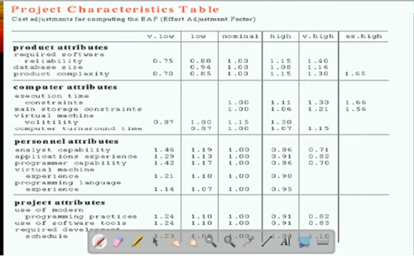
Intermediate COCOMO Model Cont.

Slide 46
Complete COCOMO Model Cont.
A major shortcoming of both the basic and intermediate COCOMO models is that they consider a software product as a single homogeneous entity
Most large systems are made up several smaller sub-systems
These sub-systems may have widely different characteristics
The complete COCOMO model considers these differences in characteristics of the subsystems and estimates the effort and development time as the sum of the estimates for the individual subsystems
The cost of each subsystem is estimated separately
This approach reduces the margin of error in the final estimate

Slide 47
Project Scheduling & Tracking
Scheduling Principles
Compartmentalization
Interdependency
Time Allocation
Effort Validation
Define Responsibilities
Define Outcomes
Define Milestones

Slide 48
Effort Distribution
General guideline: 40-20-40 rule
  40% or more of all effort allocated to analysis and design tasks
  20% of effort allocated to programming
  40% of effort allocated to testing
Although most software organizations encounter the following projects types:
  Concept Development
  New Application Development
  Application Enhancement
  Application Maintenance
  Reengineering

Slide 49
Scheduling methods
  Program Evaluation and Review Technique (PERT)
  Critical Path Method (CPM)
Both PERT and CPM provide quantitative tools that allow you to:
  Determine the critical path—the chain of tasks that determines the duration of the project
  Establish “most likely” time estimates for individual tasks by applying statistical models
  Calculate “boundary times” that define a “time window” for a particular task

Slide 50
Project Schedule Tracking
Several ways to track a project schedule:
  Conducting periodic project status meeting
  Evaluating the review results in the software process
  Determine if formal project milestones have been accomplished
  Compare actual start date to planned start date for each task
  Informal meeting with practitioners
  Using earned value analysis to assess progress quantitatively
Project manager takes the control of the schedule in the aspects of
  Project Staffing, Project Problems, Project Resources, Reviews, Project Budget

Slide 51
Risk analysis & Management
A risk is a potential (probable) problem – which might happen and might not
Conceptual definition of risk
Risk concerns future happenings
Risk involves change in mind, opinion, actions, places, etc.
Risk involves choice and the uncertainty that choice entails
Two characteristics of risk
Uncertainty
Loss
The risk may or may not happen, so there are no 100% risks (some of those may called constraints)
If the risk becomes a reality and unwanted consequences or losses occur

Slide 52
Risk Categorization: Approach-1
Project risks
Technical risks
Business risks
Sub-categories of Business risks
Market risk
Strategic risk
Sales risk
Management risk
Budget risk

Slide 53
Risk Categorization: Approach-2
Known risks
  Those risks that can be uncovered after careful evaluation of
Predictable risks
  Those risks that are deduced (draw conclusion) from past project experience (Ex. past turnover)
Unpredictable risks
  Those risks that can and do occur, but are extremely difficult to identify in advance

Slide 54
Steps for Risk Management
1. Identify possible risks and recognize what can go wrong
2. Analyze each risk to estimate the probability that it will occur and the impact (i.e., damage) that it will do if it does occur
3. Rank the risks by probability and impact. Impact may be negligible, marginal, critical, and catastrophic.
4. Develop a contingency plan to manage those risks having high probability and high impact

Slide 55
Risk Strategies (Reactive vs. Proactive)
Reactive risk strategies
  "Don't worry, I will think of something“.
  The majority of software teams and managers rely on this approach
  Nothing is done about risks until something goes wrong
  The team then flies into action in an attempt to correct the problem rapidly (fire fighting)
  Crisis management is the choice of management techniques
Proactive risk strategies
  Steps for risk management are followed
  Primary objective is to avoid risk and to have an emergency plan in place to handle unavoidable risks in a controlled and effective manner

Slide 56
Risk Identification
Risk identification is a systematic attempt to specify threats to the project plan
By identifying known and predictable risks, the project manager takes a first step toward,
  avoiding them when possible
  controlling them when necessary
Generic Risks
  Risks that are a potential threat to every software project
Product-specific Risks
  Risks that can be identified only by clear understanding of the technology, the people and the environment, that is specific to the software that is to be built

Slide 57
Known and Predictable Risk Categories
Product Size
Business Impact
Customer Characteristics
Process Definition
Development Environment
Technology to be Built
Staff Size and Experience

Slide 58
Risk Estimation (Projection)
Risk projection (or estimation) attempts to rate each risk in two ways
  The probability that the risk is real
  The consequence (effect) of the problems associated with the risk
Risk Projection/Estimation Steps
  Establish a scale that reflects the perceived likelihood (probability) of a risk. Ex., 1-low, 10-high
  Explain the consequences of the risk
  Estimate the impact of the risk on the project and product.
  Note the overall accuracy of the risk projection so that there will be no misunderstandings

Slide 59
RMMM
RMMM - Mitigation, Monitoring, and Management
An effective strategy for dealing with risk must consider three issues
  Risk mitigation (i.e., avoidance)
  Risk monitoring
  Risk management and contingency planning

Slide 60


www.paruluniversity.ac.in

